Slide 1
Kane County
Impact Fee Advisory Committee
November 10, 2016

Slide 2
Items to be Discussed
  Refined CRIP Project List
Cost Estimate for CRIP Projects
Draft Fee Structure
Draft Ordinance Revisions
Next Steps

Slide 3
Refined List of CRIP Projects
Refined since last IFAC presentation to reassign project numbering system
Integrated a few intersection projects into existing project scope
  Project 23 (Huntley Rd Corridor Improvements includes intersection improvements from Galligan Rd to Randall Rd)
Staff conducted additional coordination with municipalities
  No additional comments noted

Slide 4
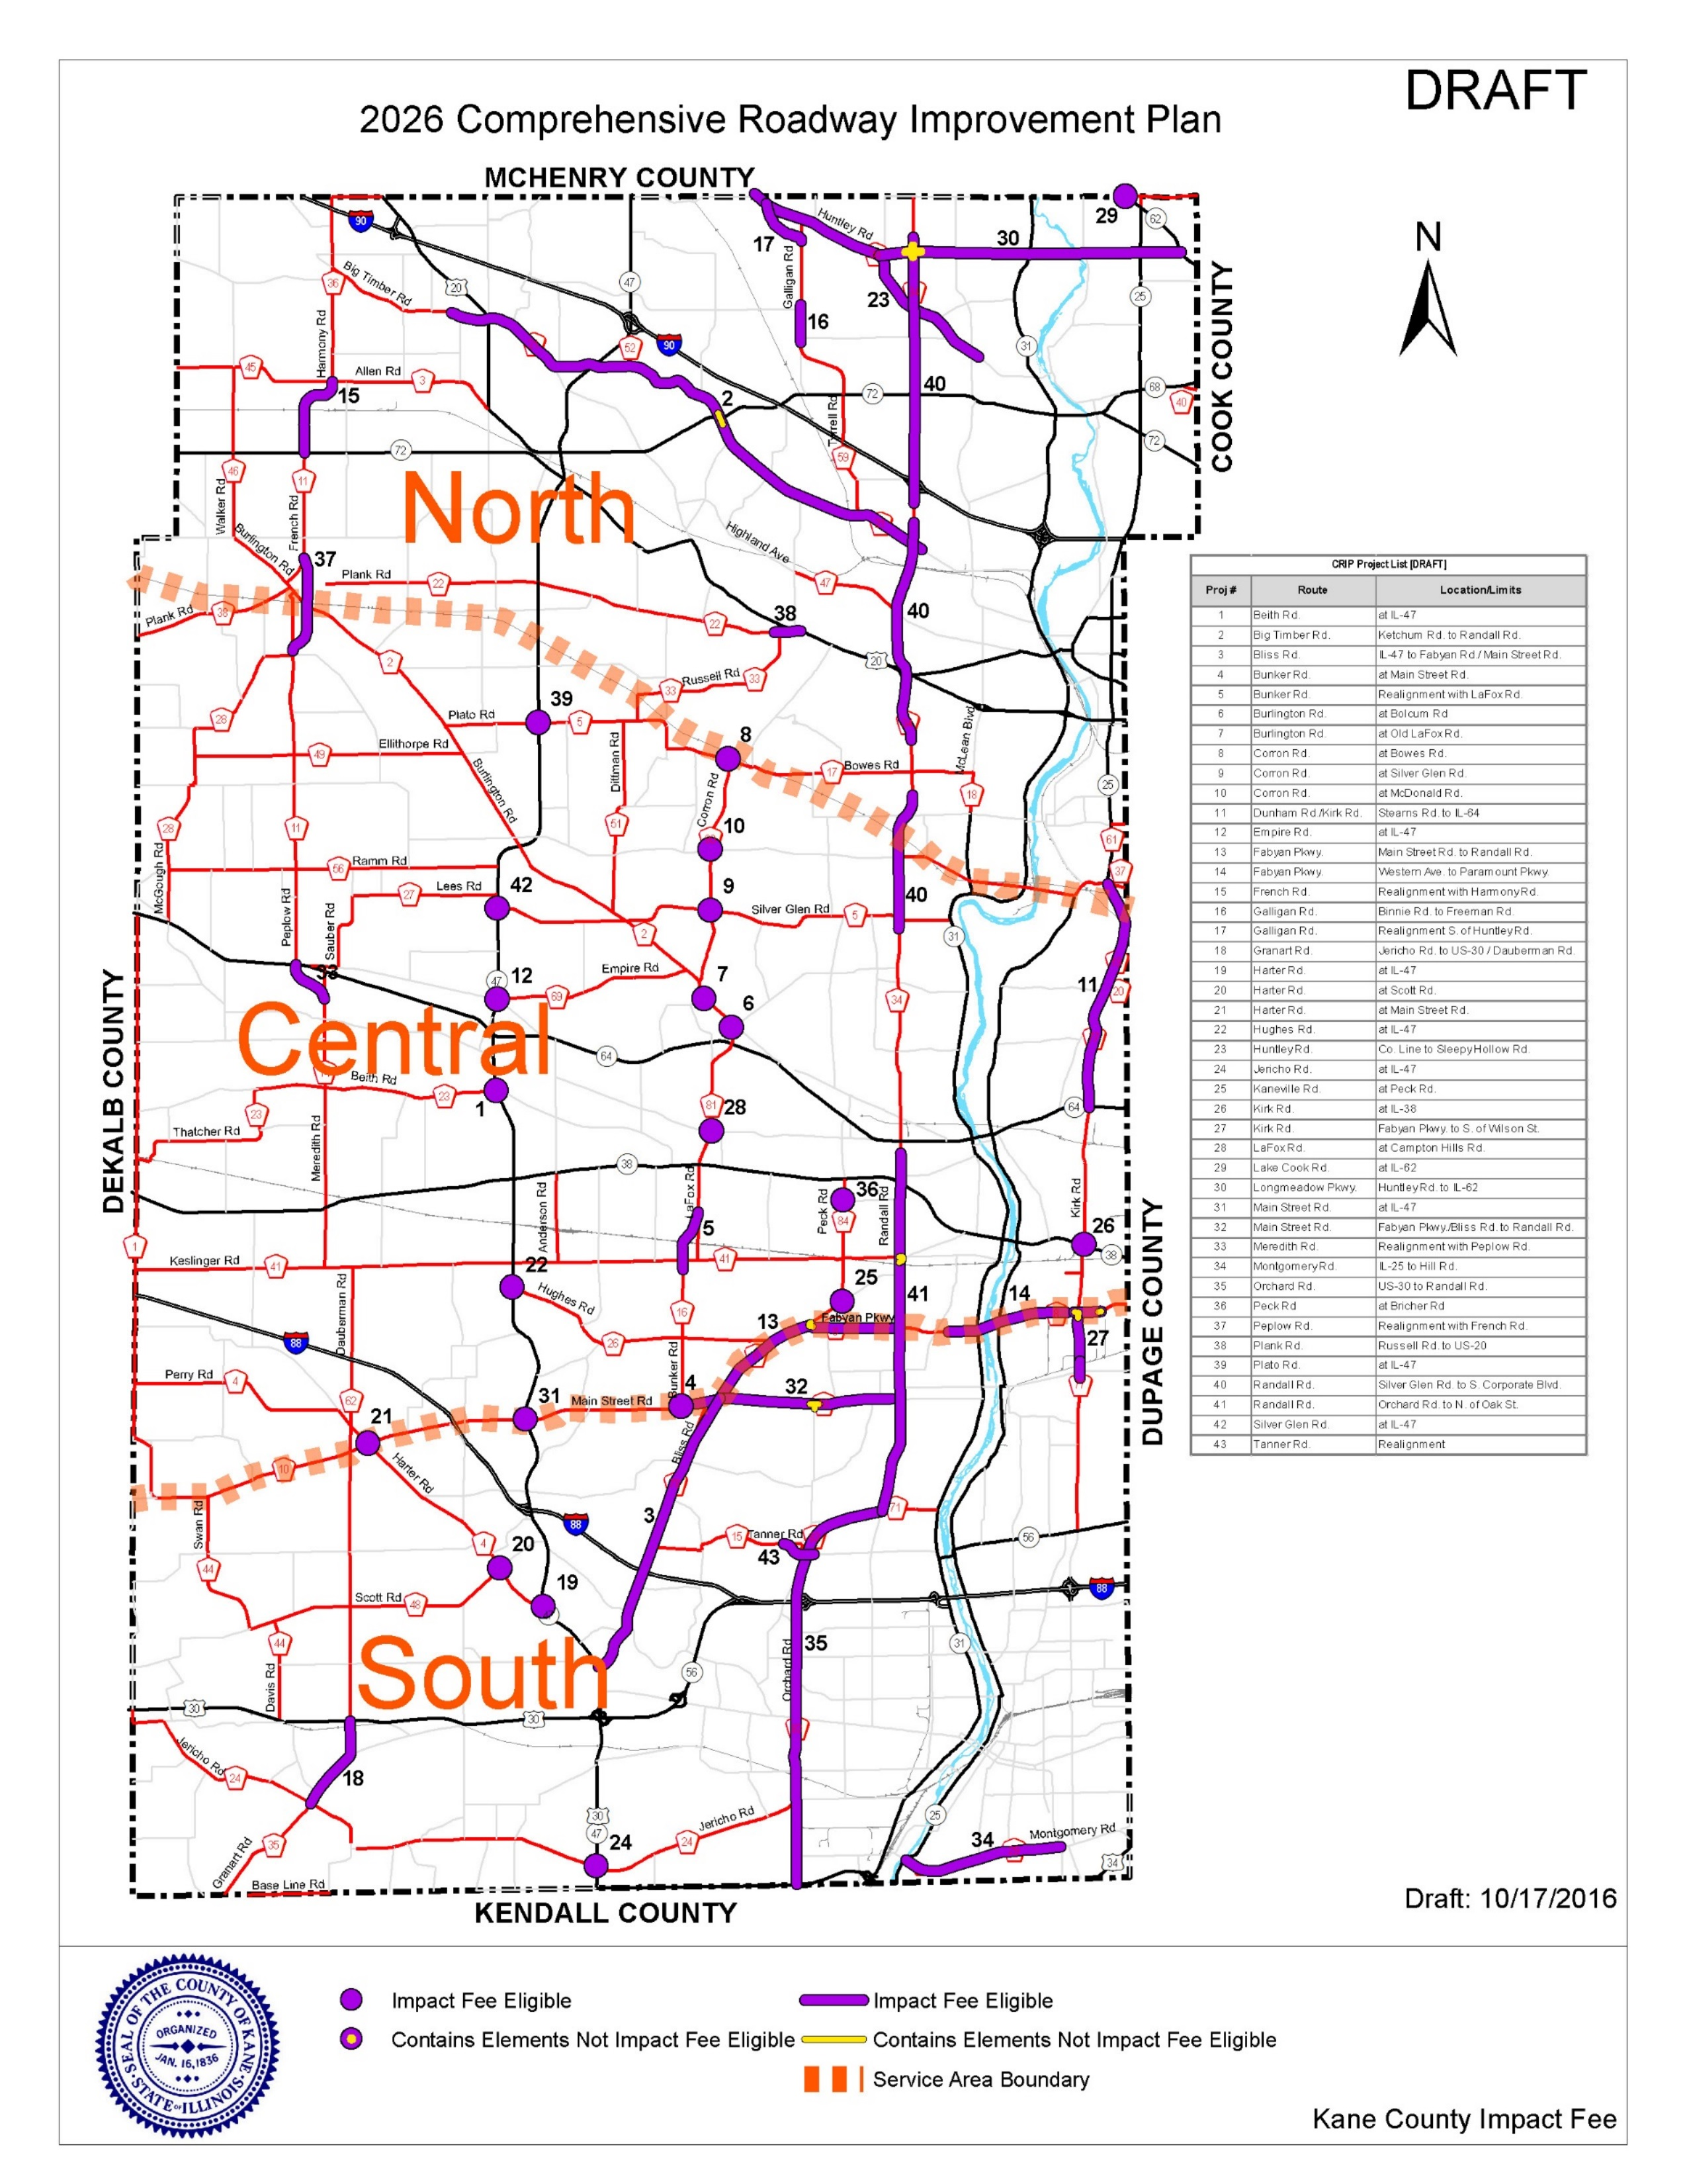
Refined CRIP Project List
Removed previously
completed projects
Renumbered projects and
sorted projects alphabetically
Total reduced from 50 to 43 projects

Slide 5



2026 Proposed Comprehensive Roadway Improvement Plan
Note: Projects elements that are not Impact Fee Eligible are represented only for the County portions of the project. Components that are on other roadway jurisdictions are not eligible for Impact Fee funds.
(DRAFT)

Slide 6
Cost Estimate Process
Costs estimated for all CRIP projects
Based on current year value - no escalation
Unit prices provided by KDOT
Incorporates more detailed estimates, where available from Phase I studies
Project costs separated at service
area boundaries for longer projects

Slide 7
Cost Estimate Summary
Draft Cost Estimate IF Program Update (2016-2026)
Total Program Cost (2016 to 2026 CRIP) | $996,080,000
Total IF Eligible Program Cost (2016 to 2026 CRIP) | $940,280,000
Expected Revenue (2017-2026) | $452,324,290
Current IF Program Cost Estimates (2011-2021)
Total Program Cost (2011 to 2021 CRIP) | $1,011,680,000
Total IF Eligible Program Cost (2011 to 2021 CRIP) | $942,400,000
Expected Revenue (2011-2021) | $371,950,000

Slide 8
Cost Per Trip
Draft Cost Per Trip IF Program Update (2016-2026)
Service Area | New Trips | Cost of Eligible Projects | Cost per Trip
North Service Area | 140,728 | $474,140,000 | $3,369
Central Service Area | 42,747 | $140,300,000 | $3,282
South Service Area | 96,298 | $325,840,000 | $3,384
County-wide | 279,773 | $940,280,000 | $3,361
Current IF Program Cost Estimates (2011-2021)
Service Area | New Trips | Cost of Eligible Projects | Cost per Trip
North Service Area | 130,266 | $474,100,000 | $3,639
Central Service Area | 39,569 | $144,300,000 | $3,647
South Service Area | 89,139 | $324,000,000 | $3,635
County-wide | 258,974 | $942,400,000 | $3,639

Slide 9
Draft Fee Structure
Maintains facilities-based approach
Maintains all current land use categories
  Additions being considered based on local input
Considers new CRIP projects and updated land use and travel demand
Fee calculation formula updated for cost per trip

Slide 10
Fee Structure Formula
Components of Fee Formula:
  Cost per Trip
    Cost of Eligible Projects within service area
    Number of New Trips within service area
  ITE Trip Generation Rate
  Gross Impact Fee per Unit

Slide 11
Example Fee Calculation
Unit x Cost per Trip x Trip Rate = Gross Fee
Single Family Attached Home in the South Service Area
  Unit = dwelling unit (1)
  Cost per Trip = $3,384
  ITE Trip Rate = 0.52
  (1 dwelling) x ($ per trip) x 0.52 = $1,760 gross fee

Slide 12
Gross Impact Fee Structure (Draft)
2016 Update
Current IF Program

Slide 13
Net Impact Fee Structure (Draft)
2016 Update ‐ Net Impact Fee Estimates with Potential Impact Fee Multipliers
2016-2026 Impact Fee Program (2016 Update: Potential Impact Fee Multipliers)

Slide 14
Ordinance Revisions Next Steps
Draft changes based on input from County staff
Considering category for “flex” industrial
Investigating revisions to:
  Definitions
  Exemptions
  Discounts
Continuing to work through revisions with staff

Slide 15
Next Project Steps
Complete proposed revisions to ordinance
Possible December IFAC meeting to discuss ordinance
Prepare for public hearing on January 4th 2017
Review and address public hearing comments
Finalize CRIP, fee structure, and ordinance for IFAC, Transportation Committee, and County Board approval

Slide 16
Near-Term Schedule
Date | Description
TBD | Possible IFAC Meeting to discuss Ordinance
Jan. 4, 2017 | Public Hearing: Draft CRIP and Fee Structure
Jan. 13, 2017 | Close of Public Comment period on Draft CRIP, Fee Structure and Ordinance
Late Jan. 2017 | IFAC Meeting: Review Draft Public Hearing Comments
March 2017 | County Board Approval: Revised CRIP, Fee Structure and Ordinance

Slide 17
Thank you!

